Slide 1
How do plants make food?

Slide 2
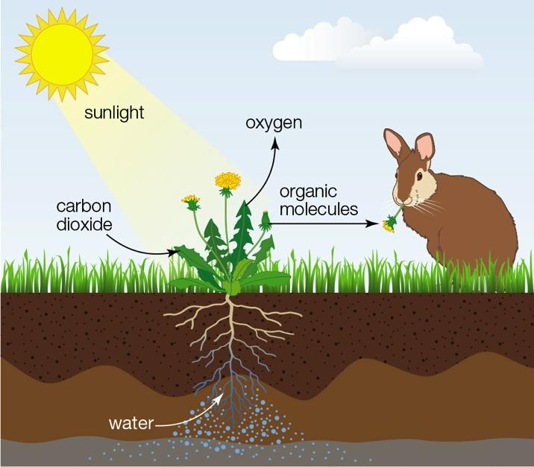
Autotrophs are producers
Make food using energy from environment and carbon from inorganic molecules
Heterotrophs are consumers
Obtain carbon from organic compounds assembled by other organisms

Slide 3
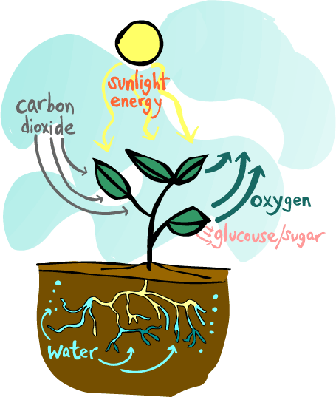
Autotrophs carry out photosynthesis
Energy flow through ecosystems begins when photosynthesizers [plants and other autotrophs] capture sunlight and convert it to chemical energy
This chemical energy can power the reactions of life, and can be stored for use at a later time

Slide 4
Photosynthesis
Photosynthesis: Metabolic pathway that uses light energy to turn carbon dioxide (CO2) and water (H2O) into carbohydrates (sugar)
Also creates OXYGEN!

Slide 5
Photosynthesis is chemical reaction.
Notes:
Discuss the reactants (inputs, ingredients) and the products (outputs, results). It takes place IN the chlorophyll, using ENERGY from the sunlight. **Sunlight is not a reactant; it is the energy.

Slide 6
Chloroplasts
Photosynthesis occurs in the chloroplast
The chloroplast is a plastid that carries out photosynthesis
Plastids are double membrane organelles that contain pigment
Chloroplasts resemble the photosynthetic bacteria they evolved from, so photosynthesis in eukaryotic cells is similar to bacterial photosynthesis

Slide 7
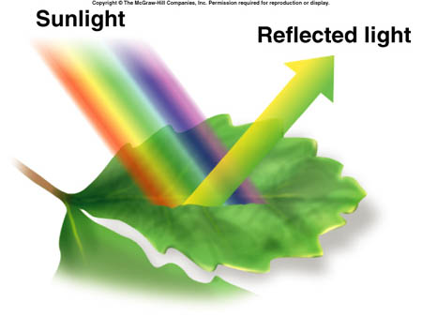
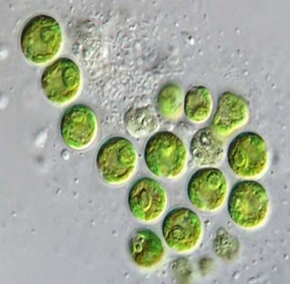
Pigment: organic molecule that selectively absorbs certain wavelengths of light
If a wavelength is not absorbed, it is reflected, and that gives the pigment its color
Chlorophyll a is the most common pigment in plants
It absorbs violet, red, and orange light, but reflects green!

Slide 8
What are some variables we could manipulate to influence photosynthesis?
reactants?
energy?
intensity?
color?
duration?

