Slide 1
Claim- Evidence- Reasoning (C.E.R.)

Slide 2
Claim
Your claim is a one or two sentence answer to the question.
Your claim must be accurate, specific, and answer the question.

Slide 3
Evidence
The evidence is all the scientific data that supports your claim.
Your evidence must be taken only from the activity (or set of activities) you are being asked to write about. It should be evidence you have collected.

Slide 4
It may include both qualitative and quantitative data.
Your evidence must be clear and specific.
It is important to have numerous pieces of evidence in order to prove your claim.

Slide 5
Reasoning
Reasoning is the explanation that connects your claim to the evidence that demonstrates why your claim is correct.
It shows a detailed understanding of the scientific principles involved and uses correct science vocabulary.

Slide 6
Claim-Evidence-Reasoning (CER)
Driving question: What characteristics of soil impact its behavior in a slake test?
Claim (Write a sentence that clearly and simply answers the question.)
Evidence: (Provide data from the observations you made during the Slake Test and the Soil Observation activities.)
Reasoning: (Write a statement that connects your evidence to your claim about how the characteristics of soil impact its behavior in a slake test.)

Slide 7
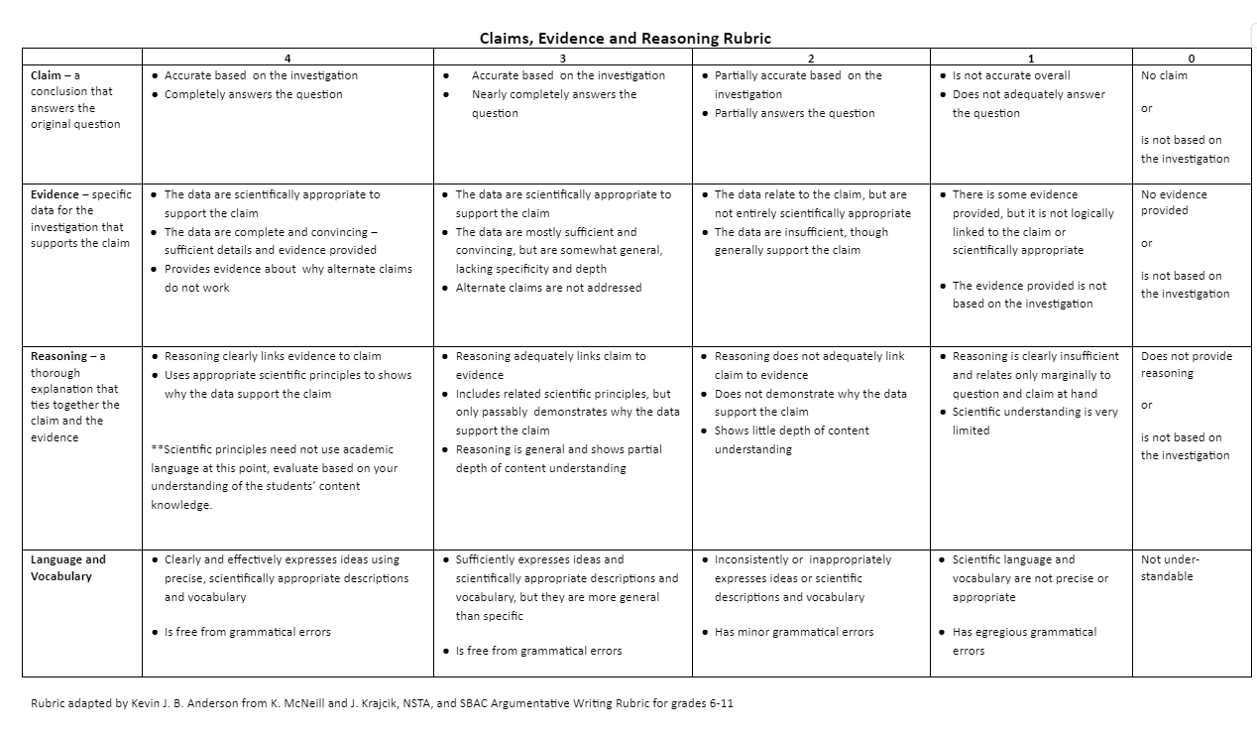
CER Grading Rubric

